Slide 1
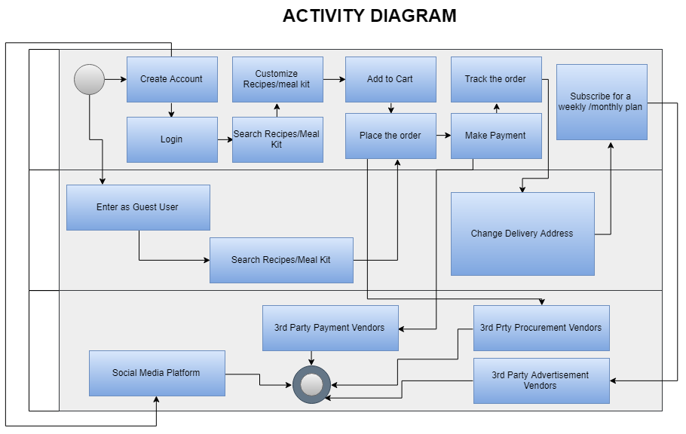
Subscribed/Registered User
Guest User
External Interfaces

